Slide 1
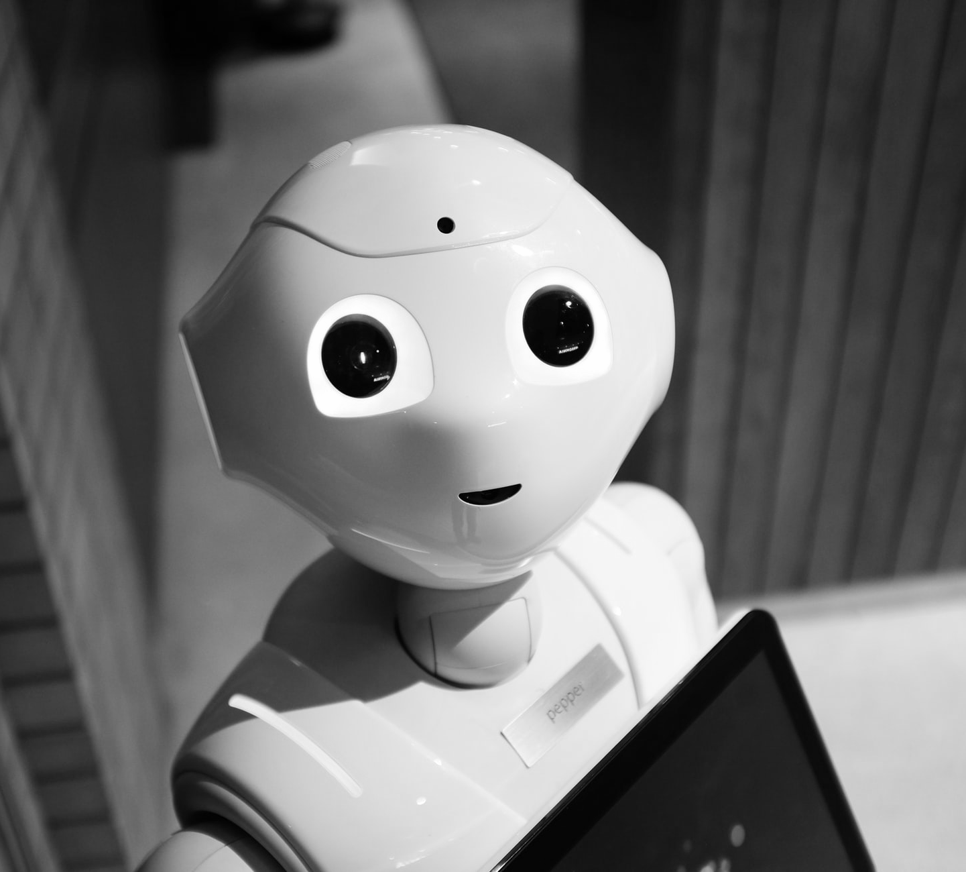
Using AI Chatbots to Recommend Restaurants: Chatbot Design & Implementation

Slide 2
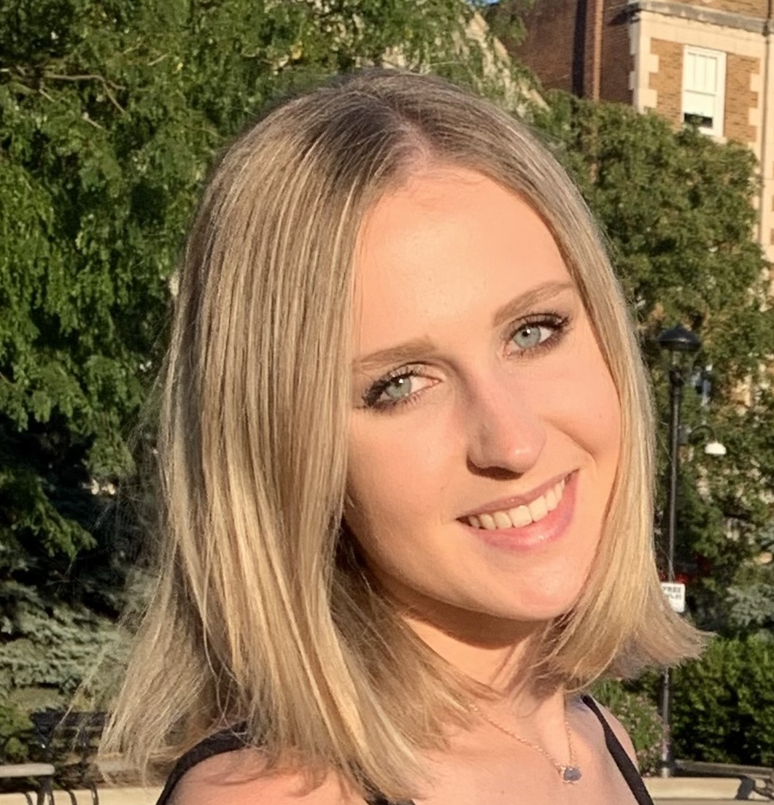
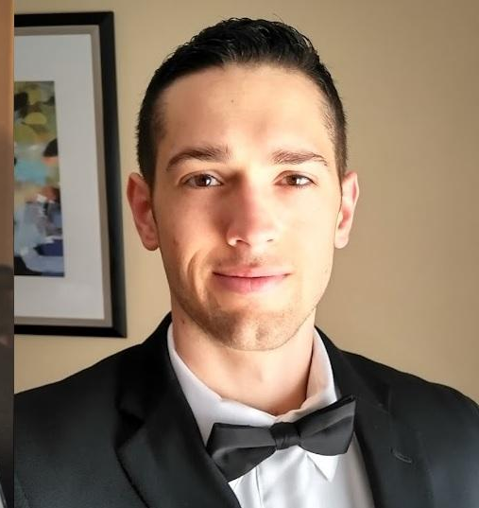
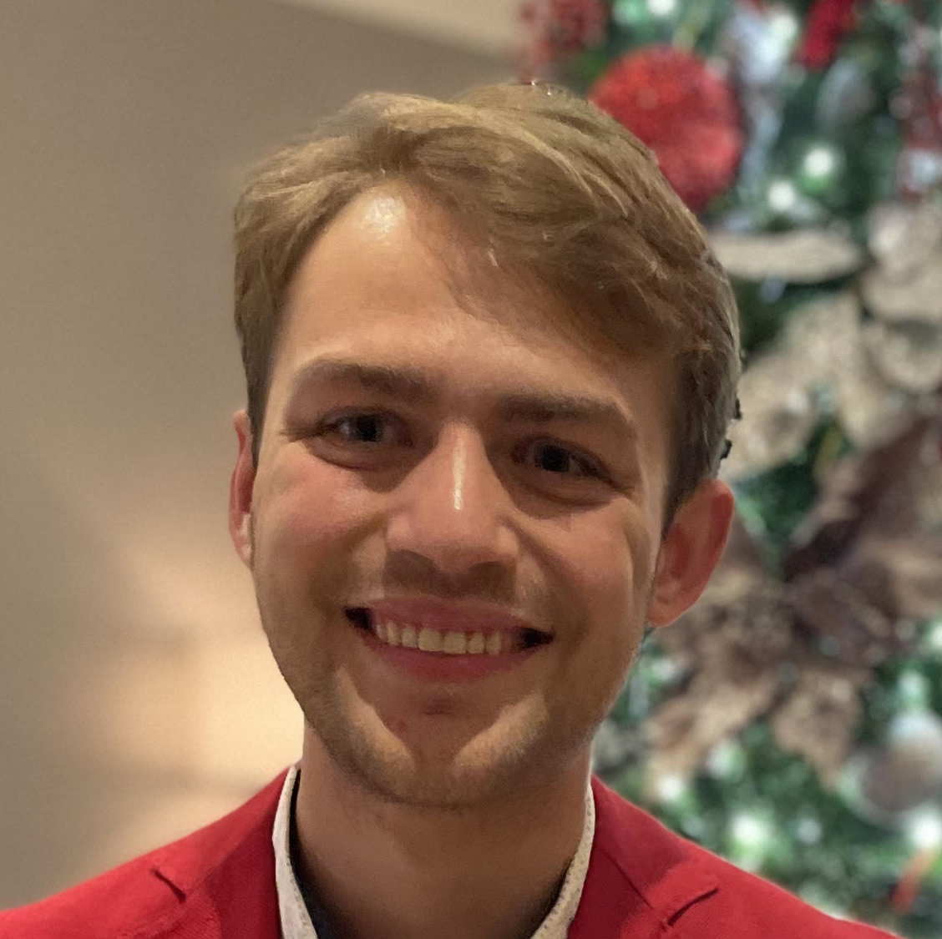
Meet the Team!
Magda Odrowaz
Buffalo Grove, IL
B.S. Kinesiology & Health ‘22
M.S. Business Analytics ‘23
Adam Brobson
Jenks, OK
B.S. Mechanical Engineering
M.S. Business Analytics ‘24
Evan Frank
Bainbridge, OH
B.S. Physics ‘21
M.S. Business Analytics ‘23

Slide 3
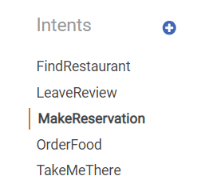
Intents
Find restaurant
Leave a review
Make a reservation
Order food
Take me there

Slide 4
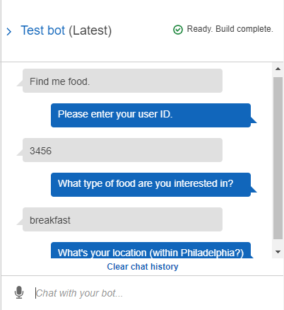
FindRestaurant: Sample Utterances
What’s good to eat
Find me food.
I want to find a restaurant.
I would like to find a restaurant.

Slide 5
FindRestaurant: Slots
Please enter your user ID.
User_ID from AMAZON.AlphaNumeric
What type of food are you interested in?
Food_Genre from AMAZON.Food slot type
What’s your location (within Philadelphia?)
Food_Location from AMAZON.StreetAddress

Slide 6
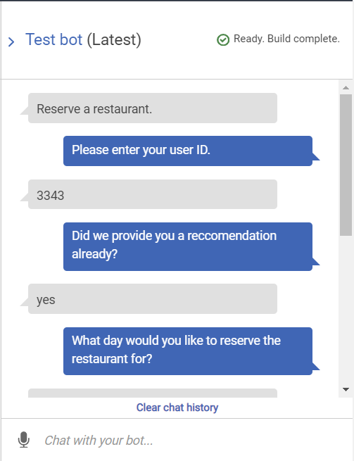
MakeReservation: Sample Utterances
Reserve a restaurant.
Make a reservation.

Slide 7
MakeReservation: Slots
Please enter your user ID.
User_ID from AMAZON.AlphaNumeric
Did we provide you a recommendation already?
Previous_Restaurant from AMAZON.AlphaNumeric
What day would you like to reserve the restaurant for?
Res_Date from AMAZON.Date
What time would you like the reservation to be for?
Res_Time from AMAZON.Time

Slide 8
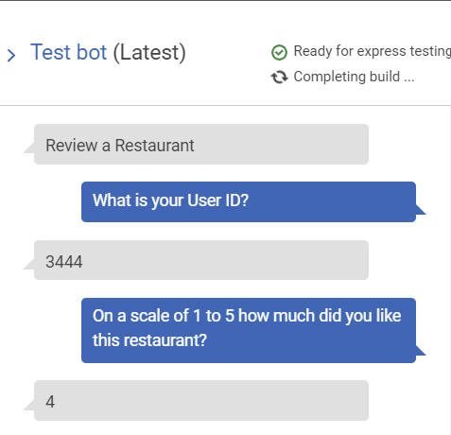
LeaveReview: Sample Utterances
Roast a restaurant.
Review a restaurant.
Leave a Review.

Slide 9
LeaveReview: Slots
Please enter your user ID.
User_ID from AMAZON.AlphaNumeric
Did we provide you a recommendation already?
Previous_Restaurant from AMAZON.AlphaNumeric
On a scale of 1-5 how much did you like this restaurant?
Review from AMAZON.AlphaNumeric

Slide 10
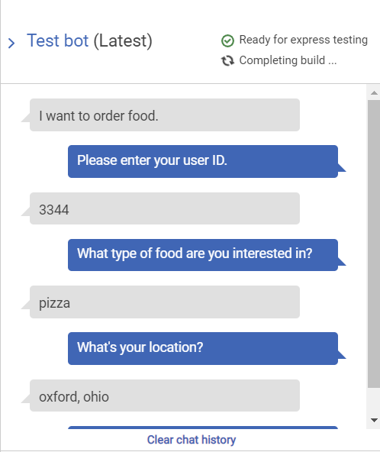
OrderFood: Sample Utterances
Please order food.
Order food.
I want to order food.

Slide 11
OrderFood: Slots
Please enter your user ID.
User_ID from AMAZON.AlphaNumeric
What type of food are you interested in?
Food_Genre from AMAZON.Food
What’s your location?
Food_location from AMAZON.StreetAddress
What time do you want your delivery?
Delivery_time from AMAZON.Time

Slide 12
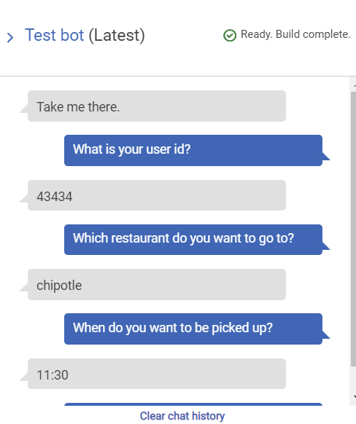
TakeMeThere: Sample Utterances
Take me to a restaurant.
I want to go eat there.
Take me there.

Slide 13
TakeMeThere: Slots
Please enter your user ID.
User_ID from AMAZON.AlphaNumeric
Which restaurant do you want to go to?
Restaurant from AMAZON.FoodEstablishment
When do you want to be picked up?
Pickup from AMAZON.Time
Where do you want to be picked up?
Location from AMAZON.StreetAddress
Do you want to use uber or lyft?
Company from AMAZON.Corporation

Slide 14
Lambda Function and Model
ALS model to provide recommendations. For intents FindRestraunt and OrderFood
Interaction with S3 to leave another review for intent LeaverReview
Create random reservation information for open hours of a restaurant for MakeReservation intent
Create random information for an uber or lyft ride for intent TakeMeThere.

Slide 15
Thank you, questions?

